Slide 1
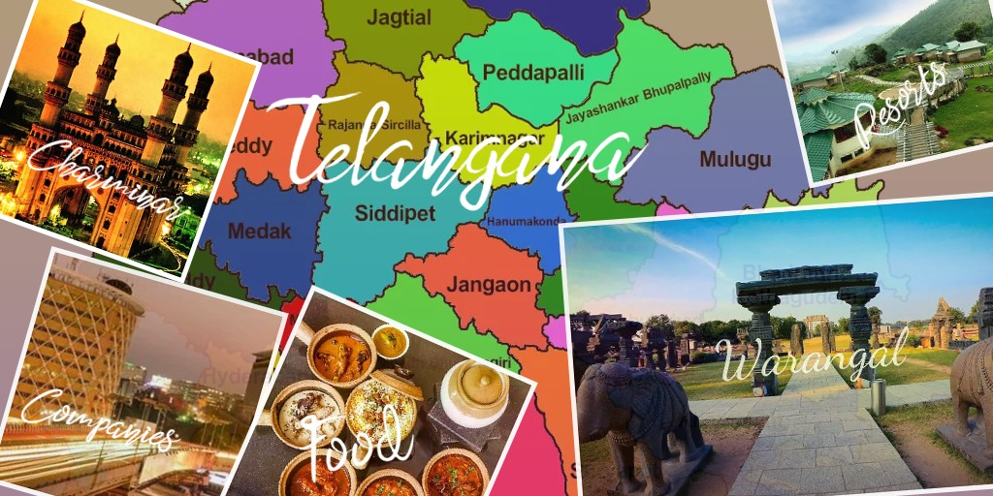
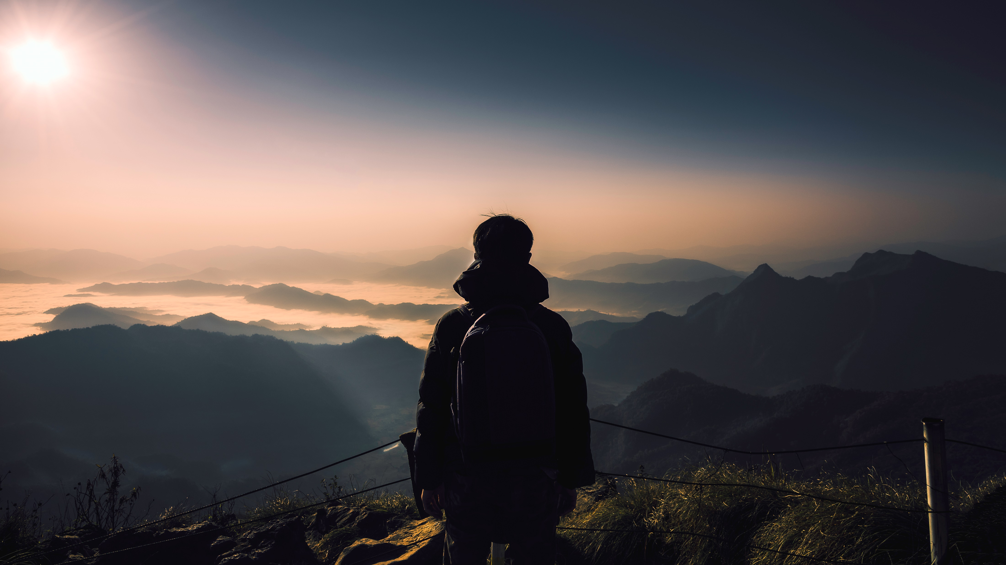
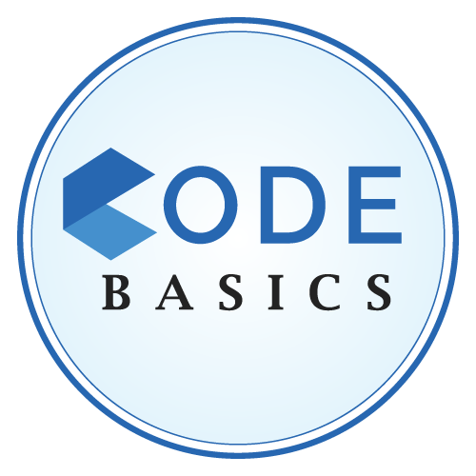
Provide Insights to Telangana Government Tourism Department
Challenge by
Balu Chelluri

Slide 2
Agenda
Context
Input data
Requests
Insights
Suggestions

Slide 3
Context
About Telangana
Telangana is one of India’s leading states and has published its tourism data under its open data policy. Posing average annual growth rate of 13.90% over the last five years.
Problem
To find the patterns in the given data, do additional research, and give data-informed recommendations to the Telangana government which can be used to increase their revenue by improving administrative operations for Tourism Department
Approach
Providing the solutions for the given requests to make the better data decisions to increase the number of visitors and revenue.
MYSQL – solutions for queries
POWER BI –Data Visualization.

Slide 4
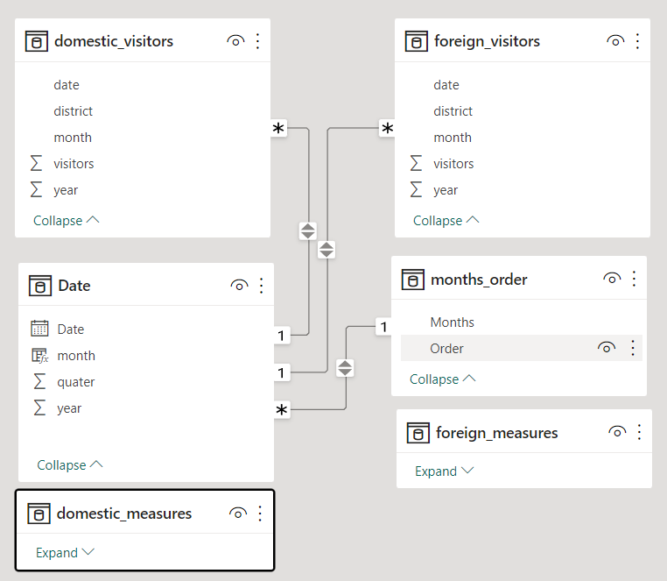
Input Data
The Tables domestic_visitors and foreign_visitors has the information of domestic and foreign tourists
monthly tourists by each districts since 2016 to 2019.
The data is provided by Codebasics from ‘https://data.telangana.gov.in/ ‘

Slide 5
The Requests Will be shown in the Power BI Dashboard

Slide 6
Insights
Foreign Visitors
Hyderabad is with 98.6% of total Foreign visitors
The number of foreign visitors has increased tremendously, almost double in three years.
The least visited months are April and May, which are in the summer season. There are a higher number of visitors in winter than in any other seasons .It is important to take advantage of the winter season market.
Many people travel to try Hyderabadi food(authentic Hyderabad Biryani) and visit the historical monuments and culture.
Domestic Visitors
The top 3 visited districts are:
Hyderabad (23.55%)
Rajanna Sircilla (11.72%)
Warangal (urban) (8.62%).
The most visited months are February and June. In February, there are a lot of traditional celebrations called Jatharas (Medaram Jatara, Peddagattu Jatara, etc.) in Telangana.
June is the time of summer holidays, and Telangana is the center of many tourist spots.
The least visited month is July, which is also the opening season for schools and the end of summer breaks.

Slide 7
Suggestions
Marketing: Increase marketing efforts in foreign countries to promote Hyderabad as a tourist destination. This can be done through various channels, such as social media, advertising, or partnerships with travel agencies.
Tourism Packages: Develop tourism packages that cater to the interests and needs of foreign visitors, such as cultural tours, food tours, or adventure sports. These packages can be marketed through various channels, such as travel agencies or online booking websites.
Ease of Travel: Simplify the visa application process and provide assistance with transportation and accommodation. This can help make it easier and more convenient for foreigners to plan their trip to Hyderabad.
Promotion of Local Culture: Highlight the local culture, cuisine, and traditions of Hyderabad to make it more attractive for foreign visitors. This can be done through cultural events, food festivals, or tourist information centers.
Online Presence: Increase the online presence of Hyderabad's tourist attractions, such as historical monuments, museums, and parks. This can be done through social media campaigns or virtual tours to attract more visitors.
Collaboration: Collaborate with other tourism boards, travel agencies, or local businesses to promote Hyderabad as a travel destination. This can help to create a network of support and resources to make Hyderabad more attractive to foreign visitors.
To improve visitors in January and December (festive season), we could make promotions and ad campaigns and offer tourist deals.
Even though Telangana has many tourist spots, there are fewer players in the market in the tourism department.
We could take advantage of government bus facilities and circulate certain bundles or packs with incentives and discounts such as:
Historic places (Golconda fort, Charminar, Salar Jung Museum, Nehru zoological Park, Museums, Chowmahalla Palace) as a Historic Bundle.
Different famous temples as a Devotional Bundle.
Different theme parks, exhibitions, museums, planetariums, shopping malls as Kids and couples Bundle.
We could make few day tour trips for the bundles with room facilities and good food. We could also release a tourism app that shows the closest tourist spots if the person wants which is similar to Tsavari (app for Hyderabad Metro).

Slide 8
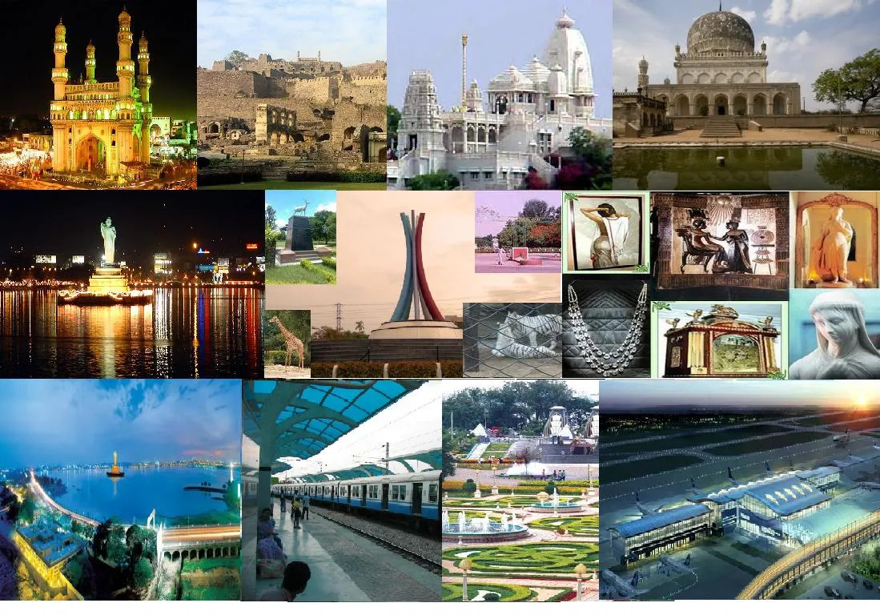
Thank you
Balu Chelluri

